Slide 1
ZIFA from 8000 to 5 dimensions –preselected for genes with < 20% zeros
Labels
Cell type
GMM
K-means
Model
PCA
UMAP
K-means

Slide 2
ZIFA from 8000 to 5 dimensions –preselected for genes with < 40% zeros
Labels
Cell type
GMM
K-means
Model
PCA
UMAP
K-means

Slide 3
ZIFA from 8000 to 5 dimensions –preselected for genes with < 95% zeros
Labels
Cell type
GMM
K-means
Model
PCA
UMAP
K-means

Slide 4
ZIFA from 8000 to 10 dimensions –preselected for genes with < 20% zeros
Labels
Cell type
GMM
K-means
Model
PCA
UMAP
K-means

Slide 5
ZIFA from 8000 to 10 dimensions –preselected for genes with < 40% zeros
Labels
Cell type
GMM
K-means
Model
PCA
UMAP
K-means

Slide 6
ZIFA from 8000 to 10 dimensions –preselected for genes with < 95% zeros
Labels
Cell type
GMM
K-means
Model
PCA
UMAP
K-means

Slide 7
Z5_p20_pca_MPP
Z5_p40_pca_MPP
Z5_p95_pca_MPP
Z5_p20_pca_STHSC
Z5_p40_pca_STHSC
Z5_p95_pca_STHSC

Slide 8
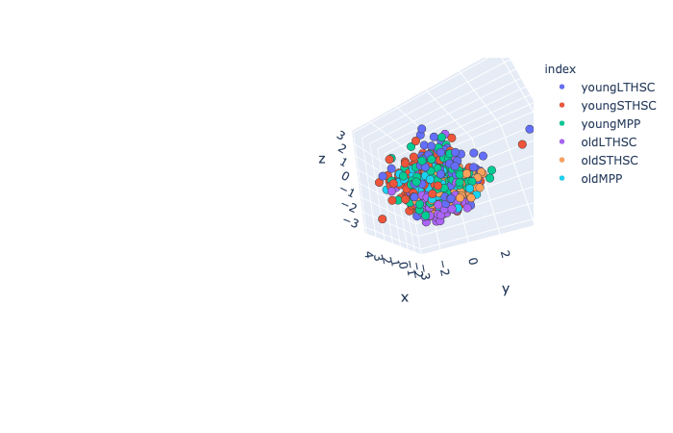
ZIFA from 8000 to 5 dimensions –preselected for low variance genes (no zeros for calc)
Labels
Cell type
GMM
K-means
Model
PCA
UMAP
K-means

Slide 9
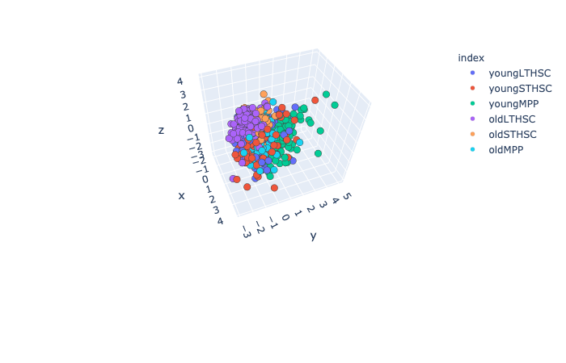
ZIFA from 8000 to 5 dimensions –preselected for low variance genes (with zeros for calc)
Labels
Cell type
GMM
K-means
Model
PCA
UMAP
K-means

Slide 10
ZIFA from 8000 to 5 dimensions –preselected for high variance genes (no zeros for calc)
Labels
Cell type
GMM
K-means
Model
PCA
UMAP
K-means

Slide 11
ZIFA from 8000 to 5 dimensions –preselected for high variance genes (with zeros for calc)
Labels
Cell type
GMM
K-means
Model
PCA
UMAP
K-means

Slide 12
Low variance preselection
High variance preselection
Z5_p95LVwz_pca_MPP
Z5_p95HVwz_pca_MPP
Z5_p95LVwz_pca_STHSC
Z5_p95HVwz_pca_STHSC

Slide 13
Z5_p20_pca_young
Z5_p20_pca_old

Slide 14
Z5_p20_pca_LTHSC
Z5_p20_pca_STHSC
Z5_p20_pca_MPP

Slide 17
